Slide 1
Special Course in Software Engineering 24
MINI-PROJECT PRESENTATION
GROUP NO. 24: Confusion Matrix

Slide 2
Group Introduction

Slide 3
Project module and module leader
Module Name | Module leaders
Data Inspection and Plotting | Qihao Zhuang, Yifan Li
Analysis and Hypothesis Testing | Bo Zhang, Yifan Li
Sentiment Analysis (NLP) | Yikai Zhang, Yifan Li
Data Cleaning and preprocessing | Yifan Li
Main Module | Yifan Li

Slide 4
Dataset

Slide 5
Dataset introduction
Dataset name:
Heart attack prediction dataset
Brief description:
The Heart Attack Risk Prediction Dataset is a valuable tool for understanding the predictors of heart health and the risk factors associated with heart attacks.
It includes diverse attributes such as age, cholesterol levels, lifestyle choices, and medical history, enabling researchers and healthcare professionals to apply predictive analytics and machine learning for proactive heart disease prevention.
With 8,763 records from patients worldwide, this dataset supports comprehensive analysis and research aimed at improving cardiovascular health outcomes.

Slide 6
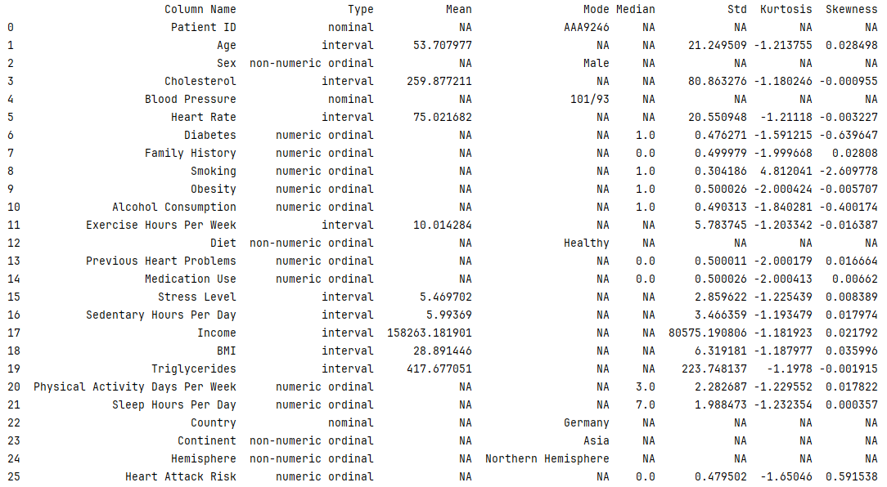

Slide 7
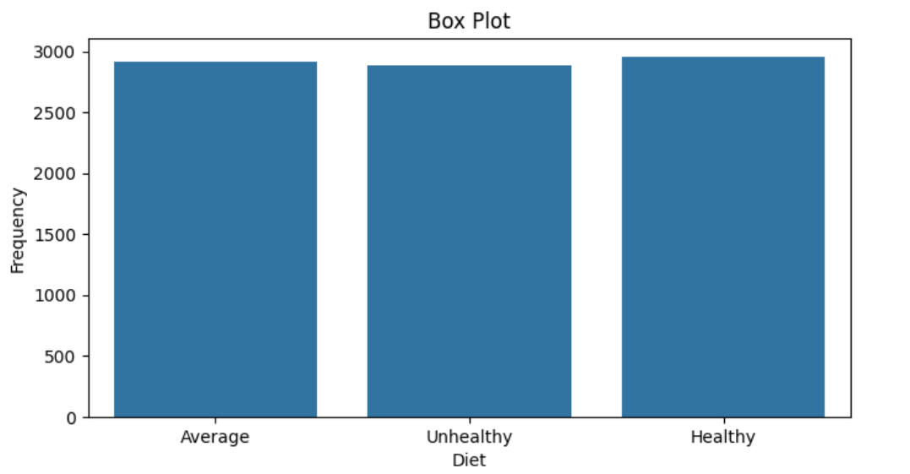
(Variable Name #Diet) distribution
This box plot compares three categories: Average, Unhealthy Diet, and Healthy.
The plot shows little to no variation within each category, as the boxes appear as single lines without visible whiskers or outliers.
All three categories have similar frequency values, around 2900-3000, with the Healthy category showing a slightly higher frequency than the others.

Slide 8
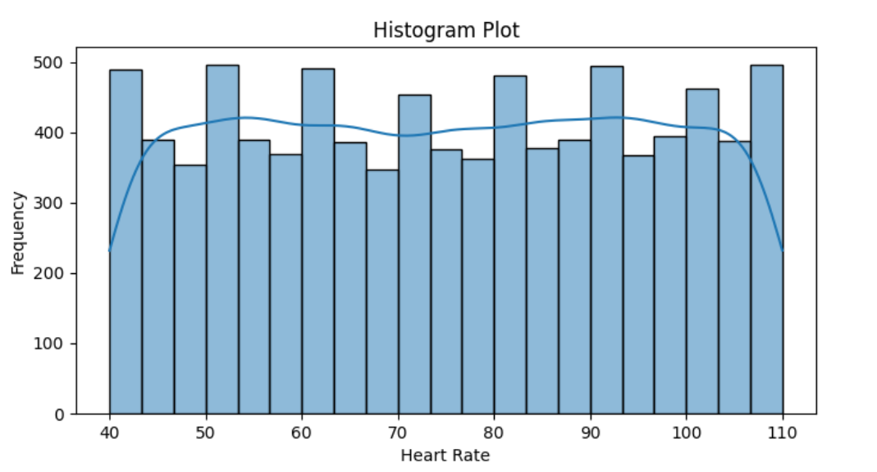
(Variable Name # Heart Rate) distribution
This histogram shows the distribution of heart rates.
The data exhibits a roughly normal distribution shape, with most heart rates concentrated in the middle range (about 70-90 beats per minute).
The distribution is slightly right-skewed, indicating that higher heart rates occur somewhat more frequently than lower ones.

Slide 9
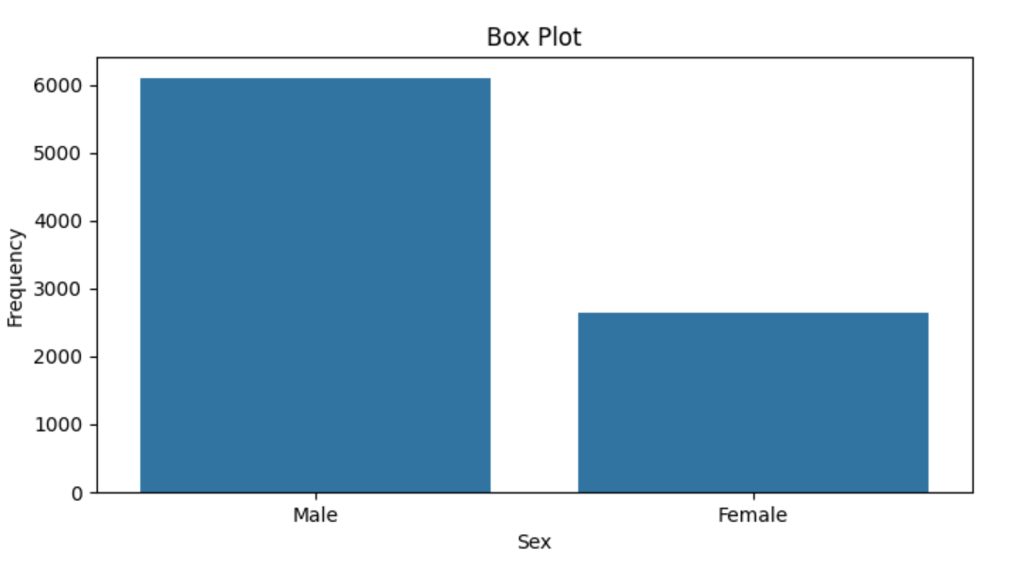
(Variable Name # Gender) distribution
This box plot compares the frequency distribution between Male and Female categories.
The Male category shows a significantly higher frequency, around 6000, compared to the Female category, which has a frequency of about 2700. The plot displays no variability within each category, appearing as single bars rather than traditional box plots with quartiles and whiskers.
This suggests the data represents aggregate counts or averages for each gender rather than individual data points.

Slide 10
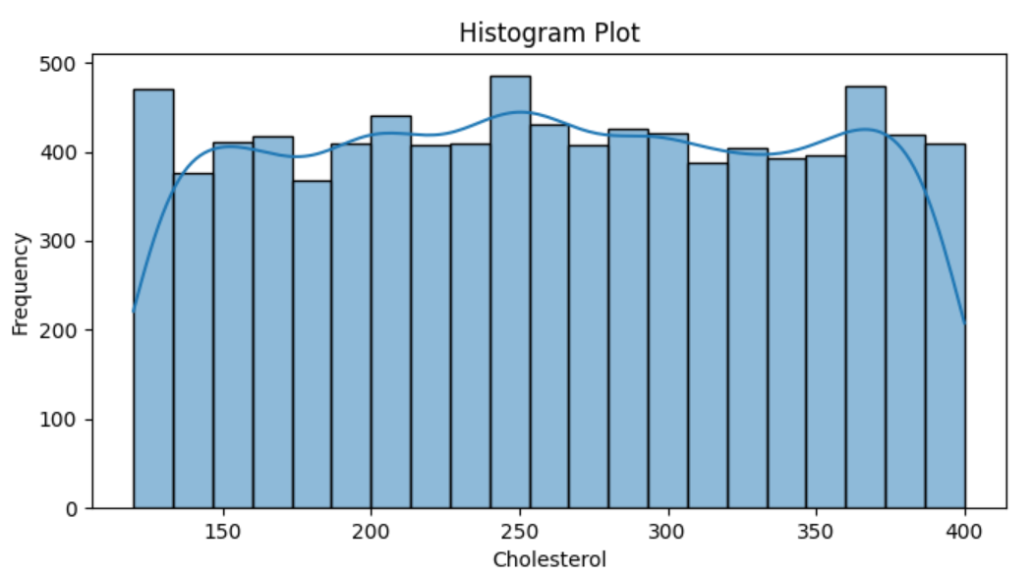
(Variable Name # Cholesterol) distribution
This histogram displays the distribution of cholesterol levels.
The data shows a relatively uniform distribution across most cholesterol values, with frequencies generally ranging between 350-450. There are slight peaks around 250 and 375 cholesterol levels. The blue line overlaid on the bars represents a smoothed trend of the distribution, highlighting these subtle variations.
Overall, the distribution doesn't show a strong central tendency, suggesting a wide range of cholesterol levels in the population sampled.

Slide 11
Analysis

Slide 12
Hypothesis #1：Analyze numeric and category data.
Analyze：
Data: Diet (Healthy, Average, Unhealthy) vs. Heart Rate
Numeric data：Heart Rate
Category data： Diet (Healthy, Average, Unhealthy)
Hypothesis：
H₀ (Null Hypothesis) : There is no significant effect of diet on heart rate.
H_{a} (Alternative Hypothesis) : There is a significant effect of diet on heart rate.

Slide 13
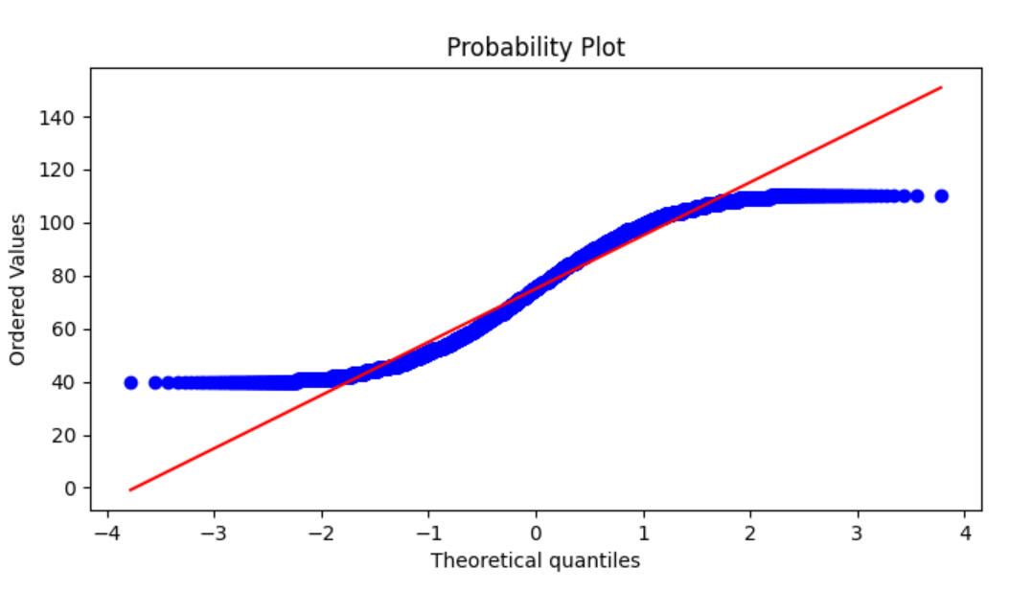
Testing Hypothesis #1
This probability plot compares the distribution of observed values (blue dots) to a theoretical normal distribution (red line).
The S-shaped curve of the data points suggests the distribution is not perfectly normal.
The middle range aligns more closely with the normal line, while deviations are more pronounced in the lower and upper quantiles.

Slide 14
Testing Hypothesis #1
"Anderson-Darling": {
"test": "Anderson-Darling",
"statistic": 102.29183776167338,
"p_value": 0.0,
"is_normal": false
}
"Kruskal-Wallis": {
"test": "Kruskal-Wallis",
"statistic": 8762.000000000002,
"p_value": 0.49799089453512324,
"is_significant": false
}
1. Anderson-Darling Test
The Anderson-Darling test is a non-parametric test used to determine whether a dataset follows a normal distribution. The statistic value of 102.29 indicates a very high degree of deviation from normality.
The p-value of 0.0 provides very strong evidence to reject the null hypothesis, which states that "the data follows a normal distribution." Therefore, the result indicates that the data does not conform to a normal distribution.
2. Kruskal-Wallis Test
The Kruskal-Wallis test is a non-parametric method used to compare three or more independent samples, similar to one-way ANOVA. Here, the statistic value is 8762.00.
The p-value of 0.498, which is above the common significance level (e.g., 0.05), indicates that there is not enough evidence to reject the null hypothesis, which states that there are no significant differences between the different samples. Therefore, the result suggests that there are no significant differences in medians among the samples.

Slide 15
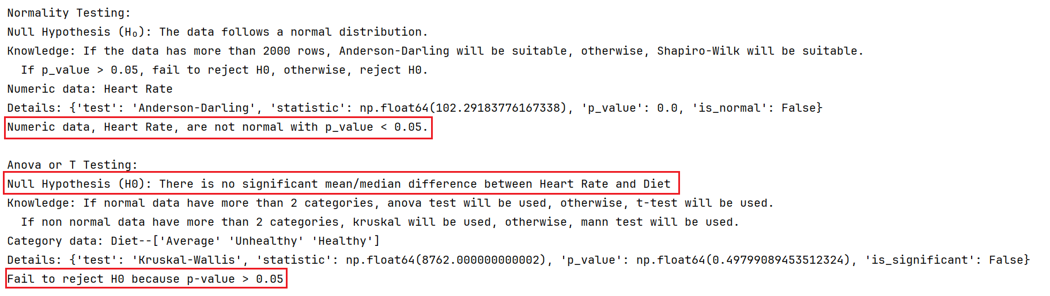
Testing Hypothesis #1
The Anderson-Darling test indicates that the data does not follow a normal distribution, while the Kruskal-Wallis test shows that there are no significant differences among the samples.

Slide 16
Hypothesis #2：Analyze numeric and category data.
Analyze：
Data: Sex vs. Cholesterol
Numeric data：Cholesterol
Category data： Sex
Hypothesis：
H₀ (Null Hypothesis) : There is no significant effect of gender on Cholesterol.
H_{a} (Alternative Hypothesis) : There is a significant effect of gender on Cholesterol.

Slide 17
Testing Hypothesis #2
This probability plot compares the distribution of observed values (blue dots) to a theoretical normal distribution (red line).
The S-shaped curve of the data points suggests the distribution is not perfectly normal.
The middle range aligns more closely with the normal line, while deviations are more pronounced in the lower and upper quantiles.

Slide 18
Testing Hypothesis #2
"Anderson-Darling": {
"test": "Anderson-Darling",
"statistic": 91.34459292230349,
"p_value": 0.0,
"is_normal": false
}
"Mann-Whitney U": {
"test": "Mann-Whitney U",
"statistic": 0.0,
"p_value": 1.0,
"is_significant": false
}
1. Anderson-Darling Test
The Anderson-Darling test is a non-parametric test used to determine whether a dataset follows a normal distribution. The statistic value of 91.34 indicates a significant deviation from normality.
The p-value of 0.0 provides strong evidence to reject the null hypothesis, which states that "the data follows a normal distribution." Thus, the result shows that the data does not conform to a normal distribution.
2. Mann-Whitney U Test
The Mann-Whitney U test is a non-parametric test used to assess whether there are differences between two independent samples. The statistic value of 0.0 suggests that one group has a lower rank than the other.
However, the p-value of 1.0 indicates that there is no significant difference between the two groups. Therefore, the result suggests that the difference between the groups is not statistically significant.

Slide 19
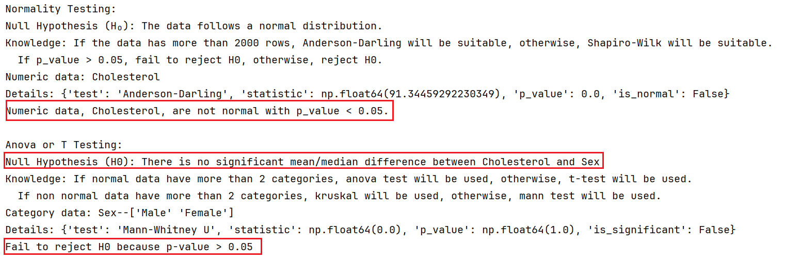
Testing Hypothesis #2
The results indicate that the data does not follow a normal distribution, as shown by the significant Anderson-Darling test statistic and p-value.
Mann-Whitney U test results suggest that there is no significant difference between the two independent samples.

Slide 20
Hypothesis #2：Analyze numeric and category data.
Analyze：
Data: Sex vs. Cholesterol
Numeric data：Cholesterol
Category data： Sex
Hypothesis：
H₀ (Null Hypothesis) : There is no significant effect of gender on Cholesterol.
H_{a} (Alternative Hypothesis) : There is a significant effect of gender on Cholesterol.

Slide 21
Testing Hypothesis #2
This probability plot compares the distribution of observed values (blue dots) to a theoretical normal distribution (red line).
The S-shaped curve of the data points suggests the distribution is not perfectly normal.
The middle range aligns more closely with the normal line, while deviations are more pronounced in the lower and upper quantiles.

Slide 22
Testing Hypothesis #2
"Anderson-Darling": {
"test": "Anderson-Darling",
"statistic": 91.34459292230349,
"p_value": 0.0,
"is_normal": false
}
"Mann-Whitney U": {
"test": "Mann-Whitney U",
"statistic": 0.0,
"p_value": 1.0,
"is_significant": false
}
1. Anderson-Darling Test
The Anderson-Darling test is a non-parametric test used to determine whether a dataset follows a normal distribution. The statistic value of 91.34 indicates a significant deviation from normality.
The p-value of 0.0 provides strong evidence to reject the null hypothesis, which states that "the data follows a normal distribution." Thus, the result shows that the data does not conform to a normal distribution.
2. Mann-Whitney U Test
The Mann-Whitney U test is a non-parametric test used to assess whether there are differences between two independent samples. The statistic value of 0.0 suggests that one group has a lower rank than the other.
However, the p-value of 1.0 indicates that there is no significant difference between the two groups. Therefore, the result suggests that the difference between the groups is not statistically significant.

Slide 23
Testing Hypothesis #2
The results indicate that the data does not follow a normal distribution, as shown by the significant Anderson-Darling test statistic and p-value.
Mann-Whitney U test results suggest that there is no significant difference between the two independent samples.

Slide 24
(NOT MANDATORY)
Interesting results
BONUS – 5 points

Slide 25
Interesting Hypothesis (NOT MANDATORY)
(
Provide details of any other interesting hypothesis you tested.
Were the results also interesting? Why?
Example (Titanic dataset):
H₀ : There is no relationship between point of embarkation and survival rate
H_{a} : There is a relationship between point of embarkation and survival rate
)

Slide 26
Interesting Hypothesis (NOT MANDATORY)
**Please note that the BONUS 5 POINTS will be given only if the teachers are convinced that the results are interesting.

Slide 27
End

